Slide 1
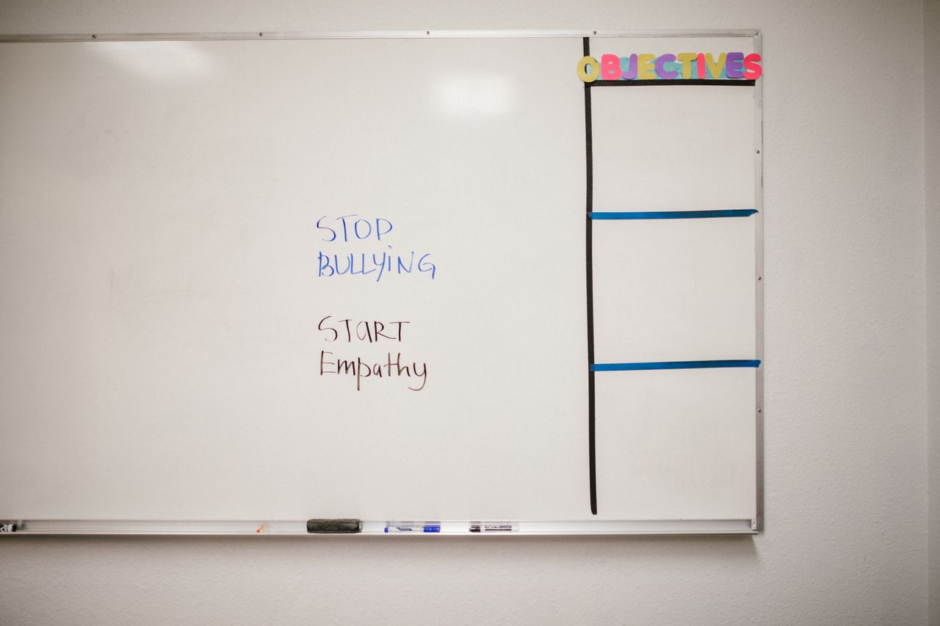
Bullying
Stops Here
Grades 7–9
Together For Health

Slide 2
1 in 3
Canadian students reports being bullied — one of the highest rates in developed countries
Bullying has serious, lasting effects on mental health, academic performance, and social development.
Together For Health

Slide 3

🔍
Understanding the Bullying Dynamic
Bullying requires: intent to harm + repetition + power imbalance
It is about power, not the victim's flaws
Bystanders are the BIGGEST factor in whether bullying continues
Most bullies have been bullied themselves — this explains, but does not excuse
Group dynamics normalize bullying when bystanders stay silent
Together For Health

Slide 4
💻
Cyberbullying: The 24/7 Reality
No escape — bullying follows victims home and into their rooms
Content spreads rapidly and can be nearly impossible to remove
Anonymity emboldens aggressors to say things they never would in person
Screenshots are evidence — save them before blocking
Cyberbullying affects mental health as severely as in-person bullying
Together For Health

Slide 5

🛡️
Being an Effective Upstander
Directly intervene if you can do so safely: "That is not cool. Stop."
1
Support the target: sit with them, send a supportive message later
2
Report to a trusted adult — every time, every incident
3
Do not share, like, or comment on bullying content — amplification is participation
4
Check in: "Are you okay? What can I do?"
5
Together For Health

Slide 6
📊
The Bystander Effect
57% of bullying incidents stop within 10 seconds when a bystander intervenes.
One person stepping up completely changes the group dynamic. You have far more power than you think.
Together For Health

Slide 7
KEY TAKEAWAYS
The bystander is the most powerful person in any bullying situation
✓
Silence = permission. Speaking up changes outcomes dramatically
✓
Building a culture of inclusion makes bullying far less likely to take root
✓
Resources
PREVNet: prevnet.ca
Kids Help Phone: 1-800-668-6868
cybertip.ca — report online bullying
Together For Health

